Slide 1
Montessori’s
Planes
Of
Development

Slide 2
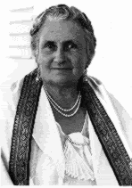
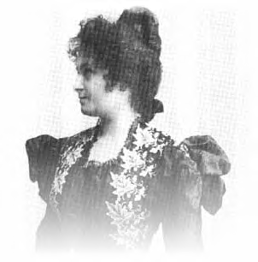
Maria Montessori
• Born in Italy in 1870
• First female physician educated in Italy
• Worked with children and observed their natural tendencies
• Created the Planes of Development based on her observations that development occurs in stages.

Slide 3
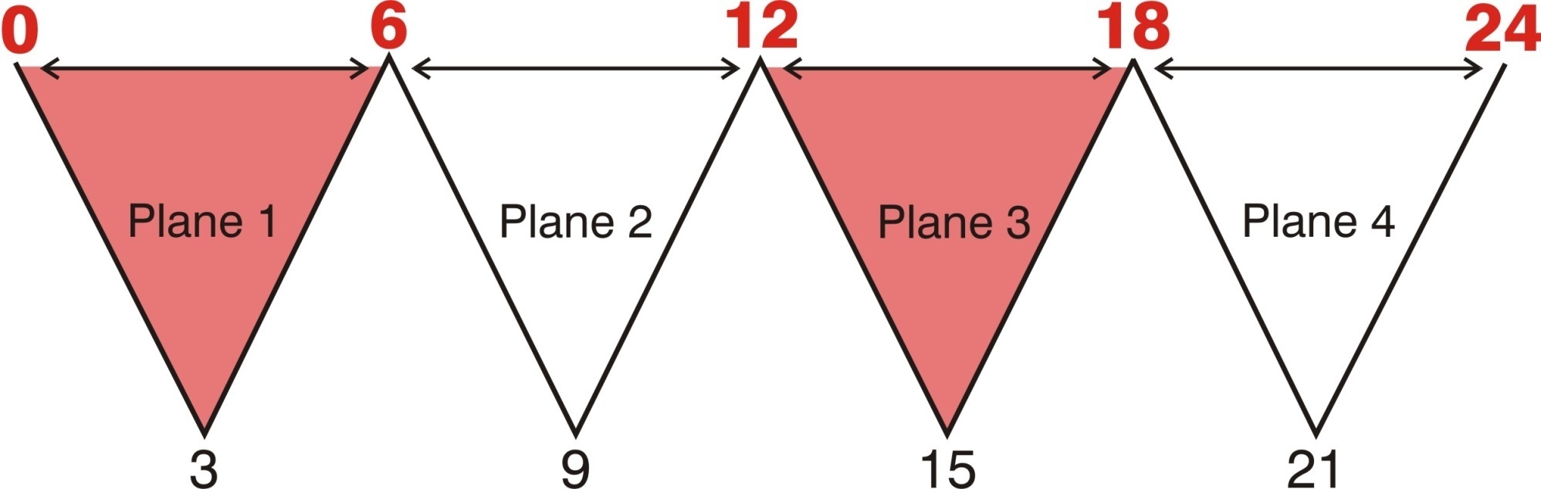
Montessori’s Planes of Development
Montessori observed that intellectual development takes place in four distinct periods called ‘planes’ or ‘stages’.
The Planes begin with the flame of life, burning throughout the stages of child development.

Slide 4
Each plane lasts 6 years and represents specific sensitive periods of development. These are times of special learning opportunities. The red numbers at the top of the chart show the ages of transition between each plane. These ages are a time of major change for the children.

Slide 5
The stages from 0-6 and 12-18 are the most dynamic periods of intellectual, social, personal, and physical growth.
The stages from 6-12 and 18-24 are times of slower and more even progress. These are the calmest periods of childhood.

Slide 6
The red lines represent the strengthening of the unique sensitivities of a given plane.
The bottom row of numbers shows the ages where the sensitivities are at their strongest. These are periods of minor transition.
The blue lines represent the last stage of a plane of development. The sensitivities of the specific plane begin to weaken and disappear.

Slide 7
Sensitive periods offer special, once in a lifetime opportunities for development. They are unconscious directives that impel children to learn and develop in new ways.
Each plane builds on the foundation developed in the previous plane. Successful development in one plane leads to successful development in the ones that follow.

Slide 8
Age 0 – 6
Sensitive Periods
• Sensory Impressions
• Language
• Sense of order & organization
• Movement
• Detail oriented
• Process oriented
• Memorization
• Refinement of senses

Slide 9
Characteristics:
Great physical growth
Unconscious intellectual growth
Order and organization is goal
Loves to repeat
Absorbs everything
Ego-centered

Slide 10
Many activities in the toddler program highlight self-help skills that lead to independence.
“Never do for a child what he can do for himself.” - Maria Montessori

Slide 11
The Montessori toddler and preprimary programs offer creative and intriguing concepts to expand their growing vocabularies.
Joining conversations, listening to stories, and learning songs and poems all nurture their budding language skills.

Slide 12
The foundation for all future studies begin in the Montessori preprimary classroom: language, mathematics, geography, biology, music, and art. These are given through individual & group lessons. The children can then explore the activities further at their own pace.

Slide 13
Age 6 – 12
Sensitive Periods
• Abstract thought
• Social awareness
• Acquisition of culture
• Use of imagination
• Questioning & mental exploration
• Manipulating concepts
• Concentration and intellectual tasks

Slide 14
From 6 to 9, emphasis is placed on building a strong academic foundation for language, mathematics, the sciences, and culture.
From 9 to 12 the child has a deepening enjoyment of culture which was acquired from age six to nine.

Slide 15
Characteristics:
Great mental growth & imagination
Dislikes repetition
Goal oriented
Social
Loves knowledge
Ready to explore the world
Strong sense of justice & honesty

Slide 16
Imagination is a great power of this age and our program is structured to nurture and support this power. This special mental ability enables the child to imagine what exists or has existed but cannot be seen because of time or distance.

Slide 17
Age 12-18
Adolescence is the 'sensitive period' for developing feelings of justice and personal dignity. These feelings are the most noble of characteristics and ought to prepare the young adult to become a social being. "
-Dr. Maria Montessori
As in the period from 0-6, this child is going through periods of rapid growth and emotional changes. The individual is ready to go out into society and use the knowledge acquired from the first two planes.

Slide 18
This is a time of heightened awareness of the individual’s role in their peer group. They seek role models aside from their parents.

Slide 19
Age 18 - 24
What has been acquired in the first three planes will be used to construct the adult being.

Slide 20

Overview of Montessori Education
Toddler Class: Age 18 months – 3 years
The toddler program offers very young children up to two years of self development in a tender atmosphere of special understanding respect, and support.
The activities in the toddler classroom highlight the self-help skills that lead to independence – hanging up their own coats, putting their work away, etc. Children are encouraged to problem solve, rather than say “I can’t.”

Slide 21
Montessori Education
Preschool Class: Age 3 - 6
The Preschool class is comprised of materials that can be divided into three main groups:
• Practical life, which are the beginning activities of daily living for
3 and 4 year olds.
• Sensorial materials isolate one defining quality such as color, weight,
shape, texture, size, sound, smell, etc. These can be used by all ages
in the classroom.
• Academic materials, which await each child’s moment of interest in
language, mathematics, the sciences, and geography.

Slide 22
Montessori Education
Elementary Class: Age 6 - 12
In the elementary class, children continue to learn individually and in groups. Long blocks of time encourage extended spans of concentration, uninterrupted by bells indicating a sudden change of subject.
The children learn to set goals, manage time, organize projects and use a variety of resources. This program gives children basic learning skills, confidence, self-esteem, an appreciation of other cultures, and peaceful techniques for conflict resolution.

Slide 23
During her lifetime, Dr. Montessori was acknowledged as one of the world's leading educators. Only recently, as our understanding of child development has grown, have we rediscovered how clear and sensible was her insight.
Today there is a growing consensus among psychologists and developmental educators that her ideas were decades ahead of her time.
One can easily say that the Montessori method, which began a century ago, is a remarkably modern approach.
Students in a Montessori school learn to respect themselves, others, and their environment. They build an excellent academic foundation and learn self-motivation, which is the key to learning for the rest of their life.

Slide 24
Presentation: Laura Altmaier
Editing & Montessori Consultation:
Aleena Meyer, Margo O’Neill, Mary Ellen Marion
Excerpts from A Parent’s Guide to the
Montessori Classroom, by Aline Wolfe

